Slide 1


Audit for PSM
focused on Chemical Industry

Slide 2
Agenda
1. Audit Objective Focused on PSM
2. Auditing Standard, Fundamentals
3. Pre-Audit Planning
4. The Opening Conference
5. Interview and Document Reviewing
6. Finding and Recommendations
7. Exercise for Writing Recommendations
8. Closing Conference
9. Post Audit Activities

Slide 3
1. Audit Objective Focused on PSM

Slide 4
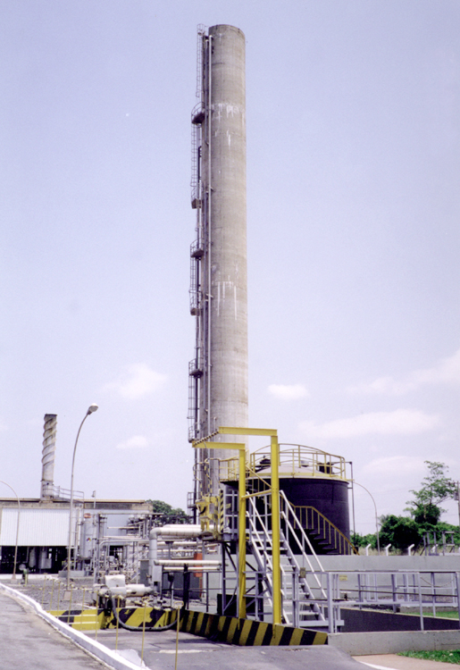
Tools for
Thinking Outside
the Box...
3

Slide 5
Why PSM Audit ?
WHAT IS AUDITING?
WHAT’S THE PRINCIPLE INVOLVED?
PURPOSE OF AN AUDIT
REGULATORY, TRADE, & PROFESSIONAL ASSOCIATION GUIDANCE
LINK TO DUPONT PSM SYSTEMS AND PERFORMANCE
LINK TO OVERALL BUSINESS EXCELLENCE
4

Slide 6
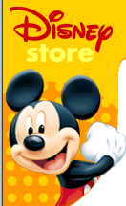
Walt Disney Co.
- Consequences of Environmental Incidents
5

Slide 7
PSM AUDITING PRINCIPLE
THE ONLY WAY ONE CAN KNOW AND
UNDERSTAND “HOW ONE IS REALLY DOING” IS BY
OBSERVING (IN THE FIELD) AND COMPARING
PERFORMANCE VERSUS ESTABLISHED STANDARDS.
PROPER AUDITING INCLUDES POSITIVE FEEDBACK
ON SIGNIFICANT STRENGTHS AS WELL AS
CORRECTIVE FEEDBACK ON AREAS NEEDING
IMPROVEMENT
6

Slide 8
PURPOSE OF A PSM AUDIT
COMMUNICATE STANDARDS
IDENTIFY DEFICIENCIES IN MANAGEMENT SYSTEMS
- INCLUDING ROOT CAUSES
RECOGNIZE STRENGTHS
PROVIDE FEEDBACK ON IMPLEMENTATION and EFFECTIVENESS OF PROGRAMS
MEASURE PERFORMANCE
MAKE RECOMMENDATIONS
7

Slide 9

PSM Auditing
PRINCIPLE
Auditing provides a measurement of compliance with the established PSRM program. Field observations yield data for determining performance against established standards.
Features:
All elements of PSRM program periodically audited
Frequency of audits established and followed
Line organization from top to bottom provides heart of auditing
Audits outside line done by safety professionals, site and/or corporate process safety group
Checklists used and documents evaluated
Results of audit documented and feedback obtained
8

Slide 10
2. Auditing Standard,
Fundamentals
9

Slide 11
SHE Audit Programs
Safety
Occupational Health
Environmental & CAER
Fire Protection
Distribution
Process Safety Management
Product Stewardship
10

Slide 12
Balance is Important!
Verifying Compliance
Consulting
11

Slide 13
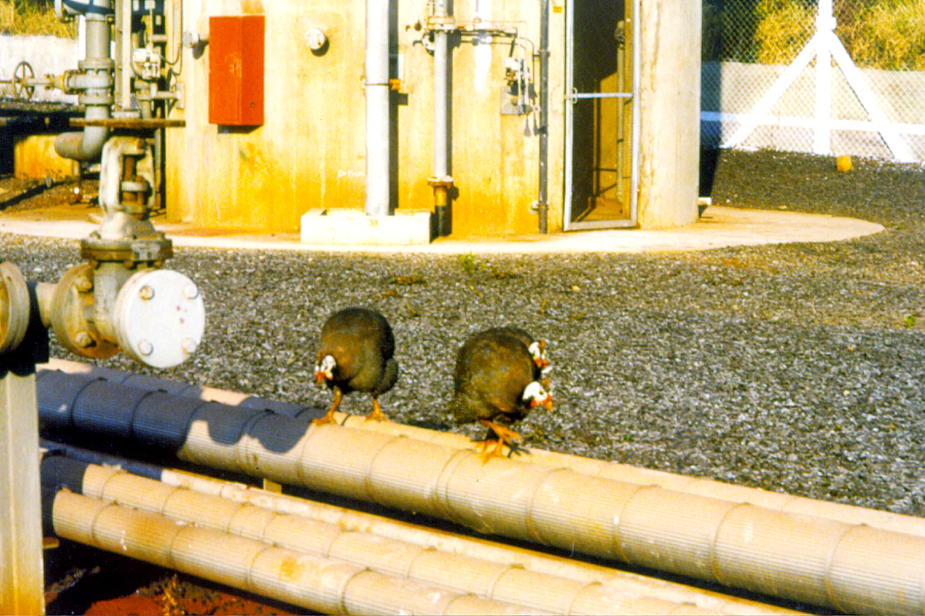
Being Not Afraid to Ask Questions...
12

Slide 14
Major Audit Phases
Pre-Audit Activities
On-Site Activities
Post-Audit Activities
13

Slide 15
SHE Audit Process
1. PRE-AUDIT
Contact Facility Leadership
Set Scope, Objectives & Timing
Form Audit Team, Assign
Responsibilities
Request, Distribute & Review
Pre-audit Information
Hold Team Meeting/Finalize Details
2. ON-SITE
Opening Conference
Review & Assess SHE
Management Systems
Test & Verify Findings
Evaluate & Classify Findings
Closing Conference
3. POST-AUDIT
Prepare Draft Report
Receive and Incorporate
Facilities Response
Prepare & Issue Final Report
4. Facility Action Plan
5. FAP Follow-up Reports
5. FAP Follow-up Reports
14

Slide 16
Auditing Methods
Document Review
Standards, Procedures, Permits, Logs
Interviews
SHE, Management, Operators
Observations/Inspections
Facilities, Equipment, Work Practices
Avoid Hearsay and Conjecture; Obtain Confirmation
Verify, Verify, Verify!!
15

Slide 17
Auditor Skills
Interviewing and Listening
Observing People and Facilities
Written and Oral Communications
Ability to Identify Root Causes
Ability to Maintain independence and Objectivity
Following all Site SHE Rules
Energy, Attitude, Flexibility, Backbone
16

Slide 18
3. Pre-Audit Planning
A Critical Activity
17

Slide 19
What Happens When It’s Not Done?
No Auditor Assignments Results in Clustering
No Knowledge of Country Regulations Results
in Incomplete Review
No Knowledge of Previous Audit Findings, Hinders Assessment of Site Progress
Disorganized Opening Conference, Damages Credibility
Lack of Agenda Causes Confusion
18

Slide 20
Key Pre-Audit Activities
Establish Scope, Objectives, Timing
Request, Distribute, Review Pre-Audit Information
Evaluate Litigation Concerns
Form the Team and Assign Responsibility
Hold Pre-Audit Team Meeting
Develop an Agenda
Finalize Administrative Details
19

Slide 21
Documents to Review in Advance
Pre-Audit Questionnaire
Audit Protocols
Recent Federal Regulations
State Regulatory Information
Corporate Standards
Previous Audit Report
Facility Background Information
Weather Reports, Directions, Site Contact List
20

Slide 22
Time Spent on Various SHE Auditing Verification Activity by Competency
21

Slide 23
What to Bring?
Selected Protocols, Standards and Regulations
Pre-Audit Questionnaire (Marked Up by Auditor)
Previous Audit Report (Marked Up by Auditor)
Safety Equipment
Appropriate Clothing
Laptop Computer
Notebook
22

Slide 24
Final Thoughts
If You Haven’t Heard from Your Team Leader,
Please Call!!
Know Where You’re Going
and When You Have to be There!!
Be Prepared!!
23

Slide 25
4. The Opening Conference
24

Slide 26
Opening Conference Agenda
Introductions & Roles
Audit Objectives, Scope and Approach
Audit Process
25

Slide 27
Audit Objectives
To Assess the Compliance with
Local Rules and Regulations
SHE Policies, Standards, and Guidelines
Site policies, Standards, and procedures
To Assess the Effectiveness of SHE Management Systems and Controls
26

Slide 28
Audit Scope
Safety
Safety Management System
Machinery, hand tools, welding safety
General workplace safety
Special workplace safety
Elevated work safety
Material Handling safety
Contractor Safety Management
Electrical Safety
Injury/Illness Classification and Record Keeping
27

Slide 29
Audit Scope
Occupational Heath
OH Management System
Chemical Risk and Exposure Assessment
Hazards control (ventilation, respirators, chemical protective clothing)
Chemical Hazards communications
Heat and Cold Stress
Noise and Hearing conservation
Indoor Air Quality
Ergonomics
Food control and Sanitation
Special Chemical Control
Laboratory OH
Asbestos and Non-asbestos Respirable Fibers (NARFS)
Integrated Health Service
28

Slide 30
Audit Approach
“Independent” Team Members
Selected Compliance Areas Addressed
Access certain practical considerations
( Sensitive and/or Restricted Area/Information,
Site Safety Rules & Procedures, transportation,
logistics, etc)
A Strict Review
A Supportive Process
A Practical Approach
29

Slide 31
On-Site Audit Process
Opening Conference
Orientation Tour
Records/Documents Review, Interviews & Observations
Verify Findings
Evaluate and Classify findings
Preparation of Draft Findings
Closing Conference
30

Slide 32
Key Audit Issues
No Site is Perfect
Audits Require Verification
Activities Will be Observed
Corrected Findings are Typically Included
Known Non-Compliances are Included
Repeat Findings Get Special Attention
Compliance Guarantees Cannot be Made
31

Slide 33
Audit Report Structure
Executive Summary
Findings Classification Summary
Findings by Section
Audit Findings and Recommendations
Overall Management Issues
By Compliance Area
32

Slide 34
Finding Structure
Description (Statement of Observation)
Requirement
Recommendation (Immediate and Long Term)
Priority ( I, II, III )
Type ( Regulation, Policy, Observation/Guidance, Commendation )
Reference
Finding Status
Business Unit
33

Slide 35
Categorizing Findings
Level I
Level II
Level III
Regulatory
Policy
Guidance
34

Slide 36
Level of Findings
Level 1: Highest Priority Action
Situations that may cause present substantial risk to the env.，the public, employees, customers, the company or its reputation, or results in criminal or civil liability for knowing or willful violations
Level 2: Priority Action
Does not meet the criteria for level 1, but it is more than an isolated or occasional situation. These actions should not continue beyond the short term.
Level 3: Action
Findings may be administrative in nature or involve an isolated or occasional situation.
35

Slide 37
Type of Findings
Regulatory
Findings involves laws, regulations, and directives that external to the company, including government regulations and international treaties.
Policy
Findings involves company policies, mandatory requirements from DuPont Standards, Site Standards or procedures.
Guidance/Observation
Findings relates to advisory guidance, good management practices (GMP), or program.
Commendation
An exemplary system, action, or program worthy of adopting by other business.
36

Slide 38
5. Interview and Document Reviewing
37

Slide 39
Interviews - Who
SHE Manager and Staff
Work Team Leaders
Operators/Technicians/Mechanics
Medical
Management/Supervision
Contractors, Drivers
38

Slide 40
Interviews - How
Introduce Yourself
Explain What You Are Doing
Try to Put Them at Ease & Relieve Stress
Ask Open-ended Questions
Don’t be Captive to the Checklist
Ask about Previous Audits
Wait For an Answer
Demonstrate That You Are Listening
39

Slide 41
Interviews - How
Keep Discussion on Track
Restate Key Findings From the Interview
Avoid Taking Excessive Notes During the Interview
Keep Names of Interviewees Confidential
Do Interviews One-on-One if Possible
Distinguish Between Inquiry and Observation
Follow-up on Leads from Interviews
40

Slide 42
Document Review Strategies
Obtain What You Can Ahead of Time, Within Reason
Do This First on Site; Many Auditable Requirements are Found in the Documents
Don’t Get Overwhelmed; Start with Strategic Documents (e.g., Written Programs or Procedures)
Ask for Quiet Time if You Need it; Nobody Wants to be Watched While They Read
Develop a List of Requirements You Want to Verify Through Interviews or Observations
41

Slide 43
Management Documents to Review
Site Organization Chart
Site Policies/Standards/SOPs
SHE Plans & Written Programs
SHE Team Meeting Minutes
SHE Training Records
Inspections & Audits
SHE Incident Investigations
42

Slide 44
Compliance Documents to Review
Inspection Logs
Performance Data
(e.g., Exposure Monitoring, Waste Water DMRs)
Manifests and Shipping Papers
Permits (e.g., Title V, Confined Space)
Equipment Calibration Records
Maintenance Records
Many Other
43

Slide 45
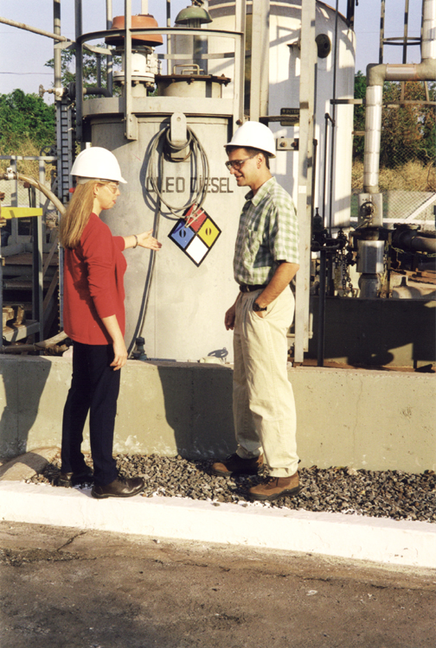
The Challenge:
Observe,
Articulate,
Write!
44

Slide 46
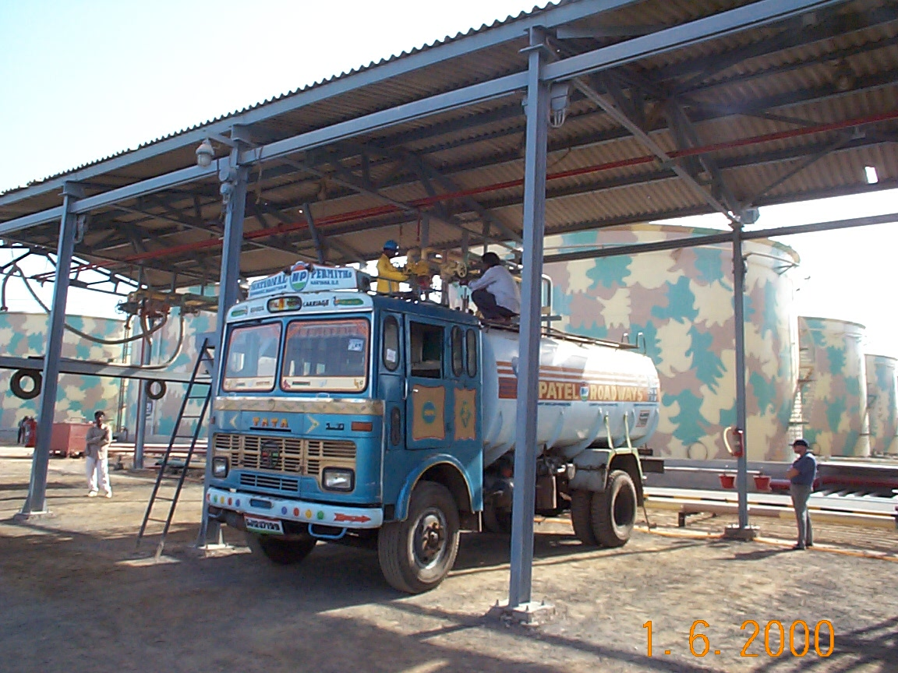
45

Slide 47
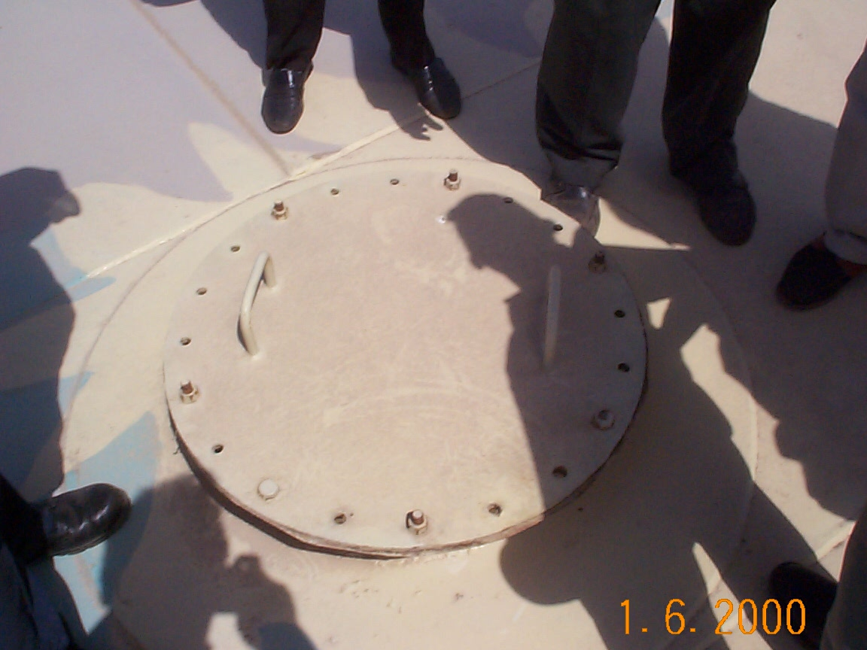
46

Slide 48
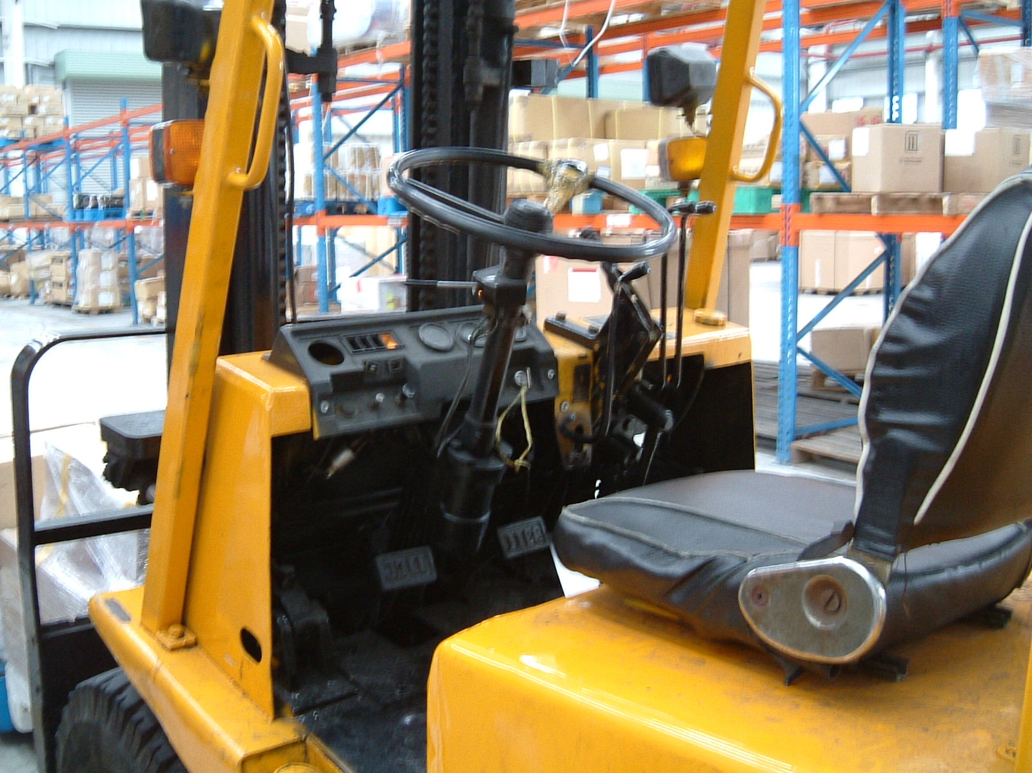
47

Slide 49
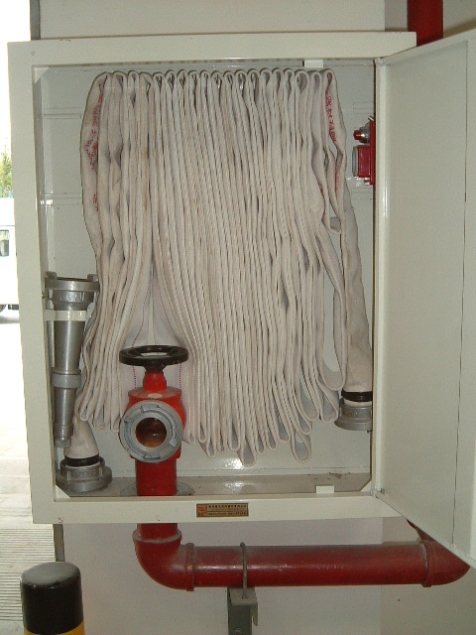
48

Slide 50
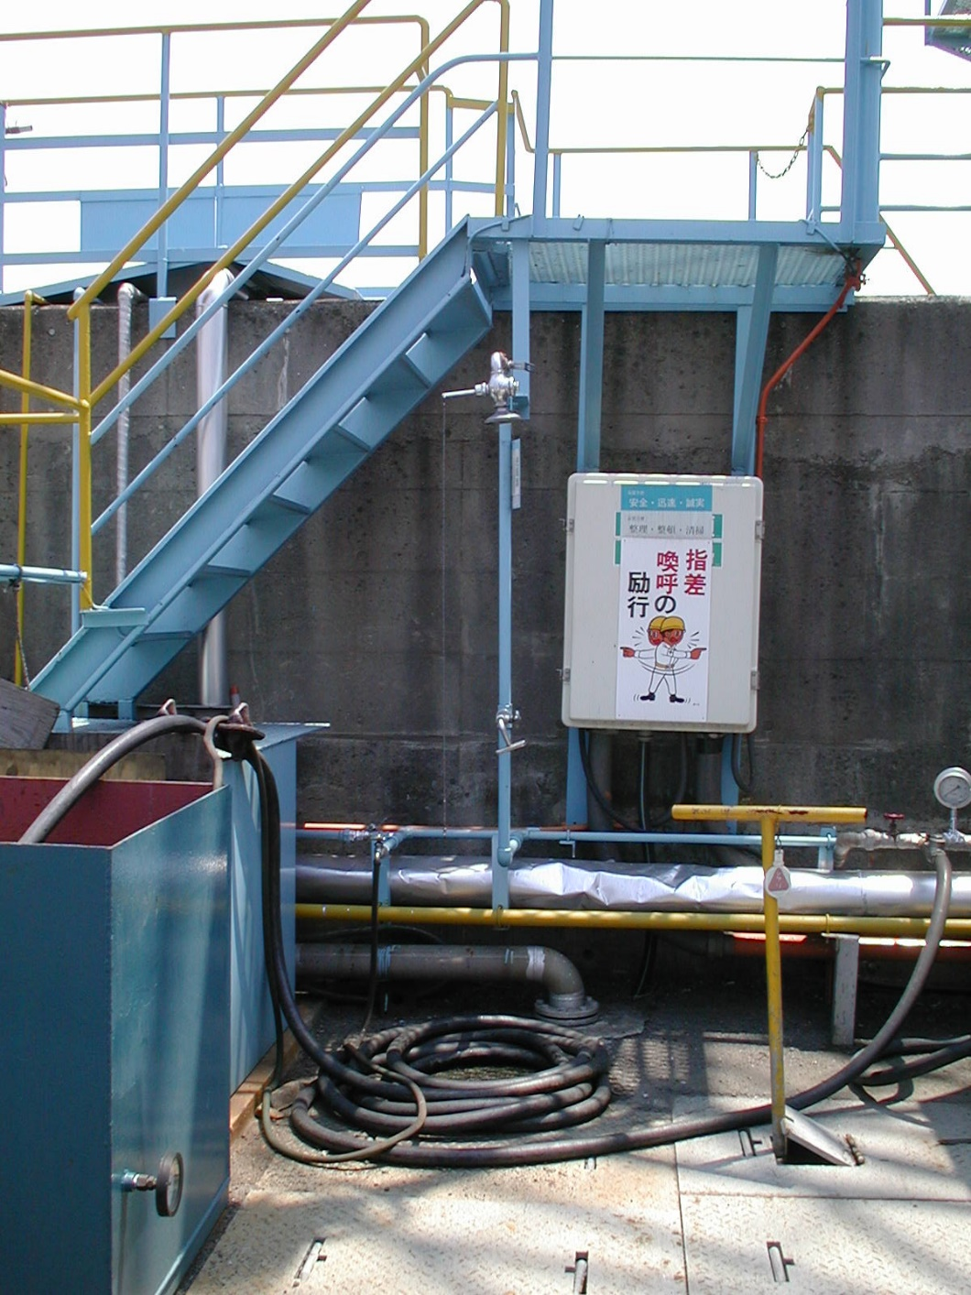
49

Slide 51
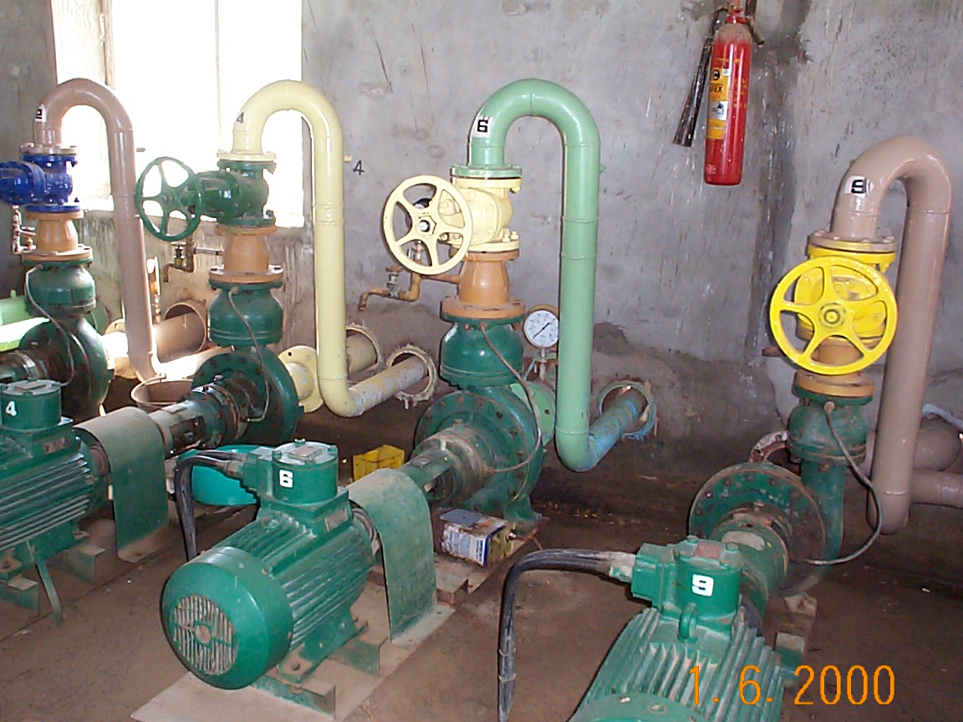
50

Slide 52
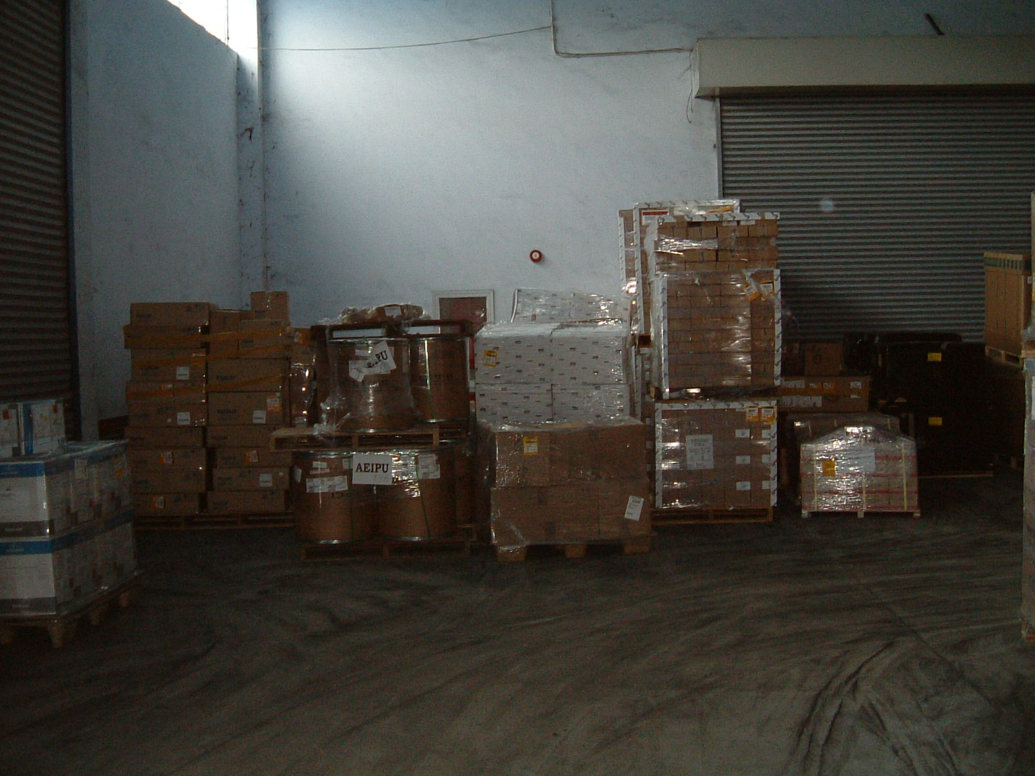
51

Slide 53
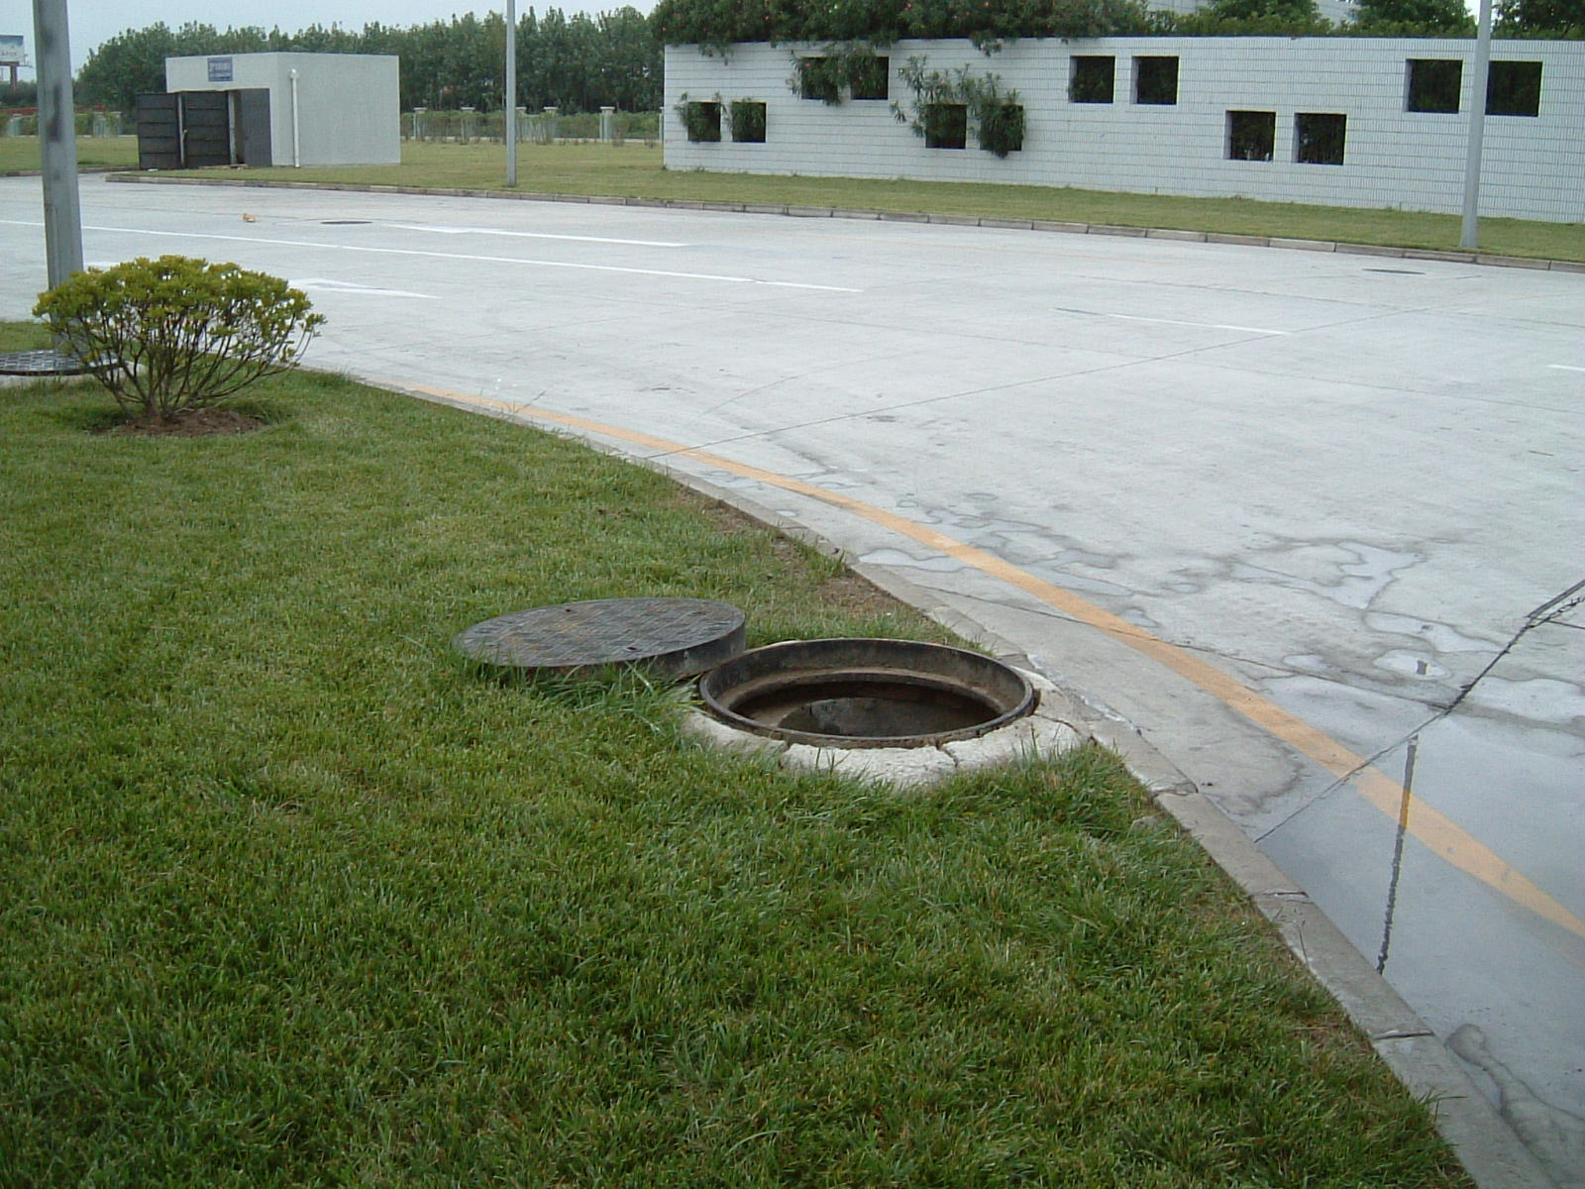
52

Slide 54
6. Finding and Recommendations
53

Slide 55
On Writing...
“Writing is Easy.
All you do is stare at a blank sheet of paper
until drops of blood form on your forehead.”
Gene Fowler
54

Slide 56
Communicating Findings -
The Four Step Process
When Observed
At the Daily Conference
At the Pre-Closing Conference
At the Closing Conference
55

Slide 57
Writing Audit Findings
Write Findings at the Management Systems Level Where Appropriate; Look for Trends
Recommend Strategic Corrective Actions (What not How)
Classify Findings
Check for Repeat Findings
When in Doubt, Use the Guide
56

Slide 58
Structure of Findings and Recommendations
Description (Statement of Observation)
Statement of Requirement
Citation
Finding Type (Regulatory, Policy, Observation/Guidance)
Finding Priority (I, II, III)
Recommendation (Immediate and Long Term)
Status
57

Slide 59
A Model Audit Finding…
Title: Hazardous Waste Accumulation Area Inspections
Description: The site could not demonstrate inspections of the 90-day hazardous waste accumulation point located on the south side of Building A23 were being conducted.
Source: Federal hazardous waste regulations require the site to inspect “areas where containers are stored, at least weekly, looking for leaks and for deterioration caused by corrosion and other factors.”
Recommendation: Provide the appropriate assurances that the inspections are occurring and/or develop and implement a verifiable inspection procedure.
Priority: Level II
Type: Regulatory
Reference: 40 CFR 265.174
58

Slide 60
The Top Four Pitfalls
Vague Observation Statements
“program is inadequate”
“program needs improvement”
No Statement of Requirement
No Citations
Overly Stringent Priority Classifications
59

Slide 61
What is a Fact?
“A matter capable of direct verification, not of
matters of judgment.”
Strunk and White, The Elements of Style
“Water boils at 100 degrees C.” [A fact]
“Napoleon was the greatest of modern generals.”
[Not a fact]
60

Slide 62
What is Not a Fact?
“The Site Needs to…”
“The Program Should be…”
“The Unit Might Have to be…”
“The Permit Could be…”
61

Slide 63
The Auditor’s Role in Report Writing
Develop “Bullet-Proof” Findings
Accurately Define the Basis of the Deficiency
Develop Logically Consistent Recommendations
Review Other Auditors’ Findings
Focus on “Directly Insertable” Text
62

Slide 64
Words of Wisdom on Writing
“Make every word tell.”
William Strunk, Jr.
63

Slide 65
7. Exercise for Writing Recommendations
64

Slide 66
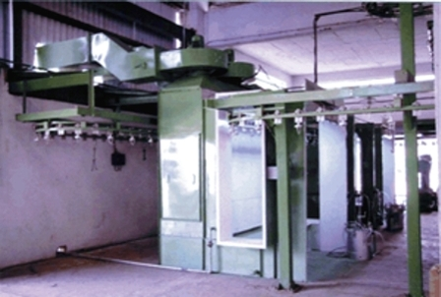
1. Mechanical Integrity
A powder coatings unit has been in operation for five years which includes a coatings chamber, a ventilation system, and the coatings spray unit. Coatings may involves flammable or combustible materials.
The unit was not included in the MI SAP maintenance program.
What MI related items should be evaluated with this equipment ?
65

Slide 67
1. Mechanical Integrity
Inspection and testing of the ventilation system flow, grounding and bonding of equipment, spray unit, filters, controls
Why was the system not included in MI program ?
Is this equipment considered “PSM Critical Items” ?
66

Slide 68
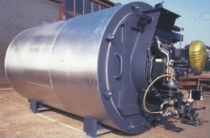
2. Quality Assurance
The site has purchased a new mixing tank which is insulated and has a mechanical agitator.
Records of Quality Assurance information cannot be located on site.
What types of QA information would you expect to see involving this purchase ?
67

Slide 69
2. Quality Assurance
Inspection and test of the tank construction
(welds, materials, supports, nozzles)
Inspection of insulation
Functionality of agitation system
68

Slide 70
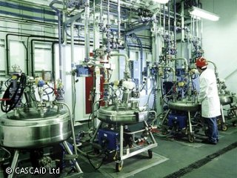
3. Management of Change - Personnel
A specialty chemical (Lubricants) process uses highly toxic materials (phosgene, fluorine) and flammables.
A new supervisor has been transferred into the area from another site. He has been in the area for five months. MOC-P forms have not been completed.
What training and information would you expect him to have in this new role?
69

Slide 71
3. Management of Change - Personnel
Initial training on PSM and PSM systems within the site/area
90 day competency demonstration – hazards of the process, layers of protection, process technology
Inventory of PSM skills and long term targeted development program
70

Slide 72
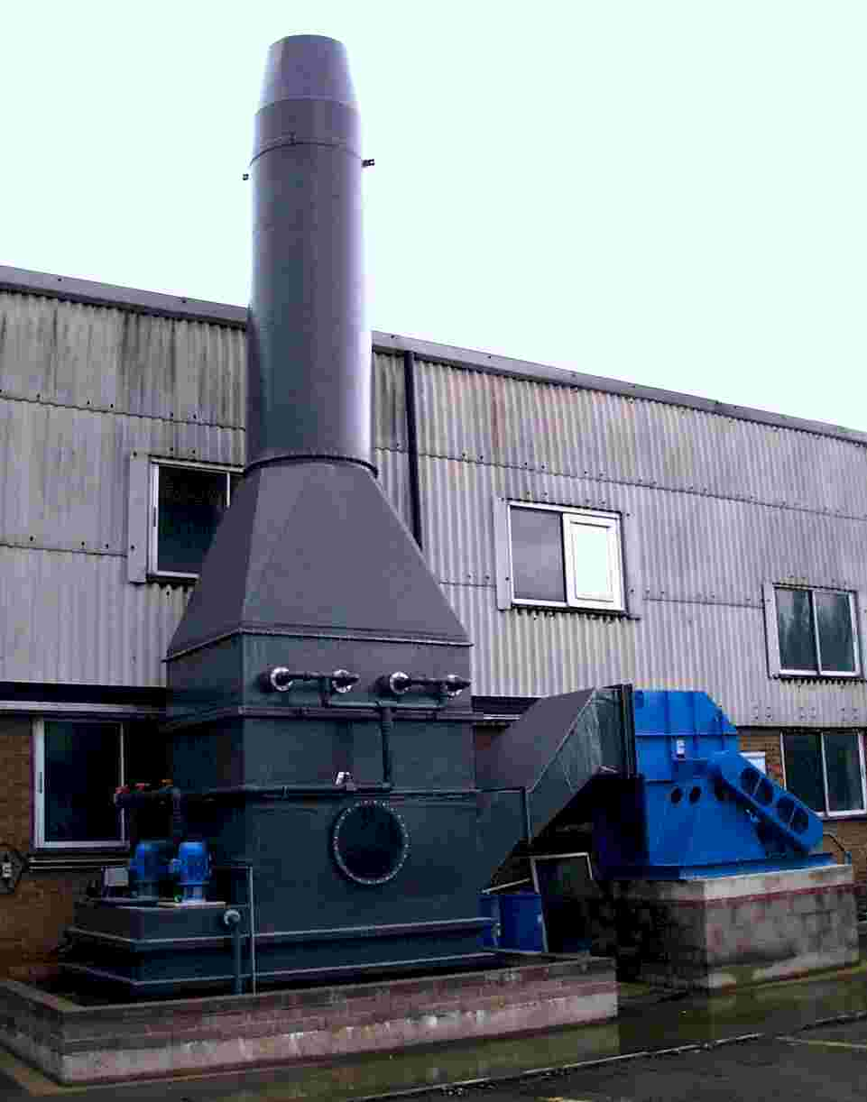
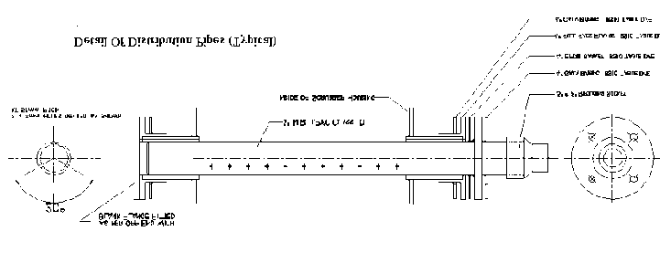
4. Process Technology
The site recently installed a new scrubber system to reduce emissions. Information on the standard operating conditions is not available.
What types of SOC’s should be expected with this type of system?
71

Slide 73
4. Process Technology
Temperature and flow of gas treated
Scrubber operating temperature
Scrubber liquid levels
PH levels
72

Slide 74

5. Training and Performance
During field interviews, shift operators indicate that a number of new filter devices and procedural steps have been installed to increase yields (6S project). The procedures have been updated but “not much” training was provided on this shift.
The equipment isn’t working well and the vendor has been troubleshooting for past two weeks.
How would you address these comments as an auditor?
73

Slide 75
5. Training and Performance
Interview other operators to review any training if provided
Review training records on changes to equipment/procedures
Interview MT engineer for area to understand troubleshooting issues
74

Slide 76
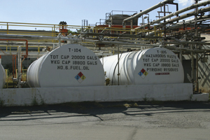
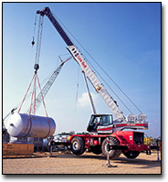
6. Safe Work Practices
The site is installing a new project to double capacity of a specialty chemical product.
A contractor construction crew is installing the equipment which includes hoisting new equipment with a crane over the existing flammable storage tanks.
The contractor is not aware of any critical lift procedures or permits.
What questions should be asked as part of a field audit in this situation?
75

Slide 77
6. Safe Work Practices
Is there a site critical lift procedure/permit?
If so, why is the contractor not using it?
Who is managing the contractor work?
What is the contractor’s crane training
and qualifications?
76

Slide 78
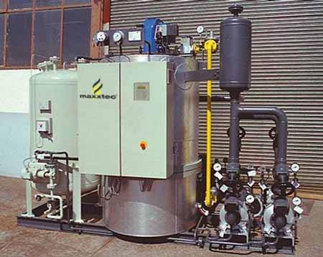
7. Prestart Up Safety Review
The site has purchased a commercial skid mounted hot oil system to replace the in plant system which failed,
The system includes pressure tanks, heating system, controls, safety interlocks and relief valves. The system has been in use for one month with no PSSR.
As a auditor, what would you expect to review as part of a PSSR?
Skid mounted hot oil system
77

Slide 79
7. Prestart Up Safety Review
Operating procedures
Quality Assurance review
Operator Training
Equipment design
MI tests and inspections
PHA recommendations
Emergency response plans
Post start up punch list
78

Slide 80
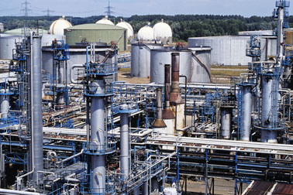
8. Auditing
A large multi-unit site contains a common tank farm storage area for raw materials and finished products which includes atmospheric storage tanks and pressurized spheres.
The tank farm area was not included in the first party audit program.
What additional items within the audit program should be reviewed based on this gap?
79

Slide 81
8. Auditing
Accountability for each process area with interconnections
Overall completeness of 1st Party audit scheduling (master schedule)
Was this reviewed during a 2nd party PSM audit
Specific focus on PSM element implementation and field evaluation in the tank farm
80

Slide 82
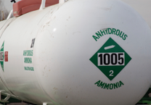
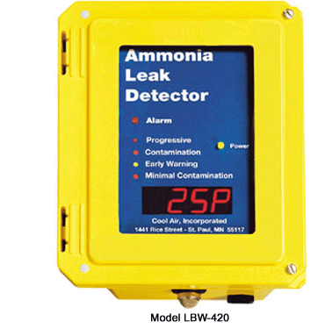
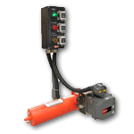
9. Operating Procedures
A site handles large quantities of anhydrous ammonia, The area recently has installed multiple ammonia detectors and a new SIS with emergency shutdown devices.
This equipment is not currently included in the operating procedures.
What other questions might be asked by an auditor to understand why this is missing in the procedures
Digital valve controller for SIS interlocked with NH3 detectors and emergency S/D
81

Slide 83
9. Operating Procedures
Why was this new equipment installed?
Was an MOC – Technology completed?
Was a PSSR completed and if so, did it look at procedures?
Have operators been trained on the new safety devices?
Have they been tested to ensure functionality ?
82

Slide 84
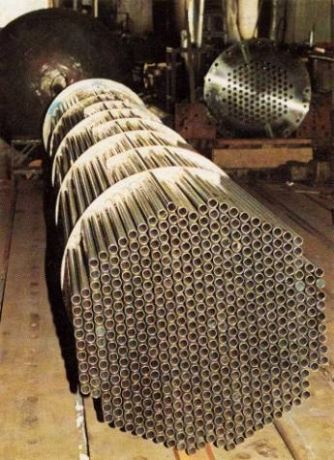
10. MOC- Technology
A plant which handles nitric acid changed the materials of construction of the tube assembly for a one year test to measure its resistance to corrosion.
A formal MOC- Technology review and approval was not completed for the trial.
What additional areas should be evaluated during the audit for this MOC
Zirconium alloy tube bundle for nitric acid vaporizer re-boiler
83

Slide 85
10. MOC- Technology
How is the site tracking the trial duration?
Was a PHA completed for this change and if so, are the recommendations in place?
Was a PSSR and QA check completed for this new alloy – if so, how?
Has there been MOC training provided to the line organization in the past?
84

Slide 86
8. Closing Conference
85

Slide 87
Preparing for Closing Conferences
If You’ve done it Right, the Closing Should be Boring
Assure the Plant Manager Will be There
Give Yourself Enough Time to Prepare
Double Check Technology
86

Slide 88
Closing Conference Structure
Discuss Agenda and Timing
Review Audit Scope and Objectives
Start on Positive Note
Give Thanks for Cooperation
Communicate Findings Objectively
Discuss Follow-up Requirements
Finish Strong
87

Slide 89
Closing Conference Tips
Hold a Pre-Meeting with SHE Management
Take Charge of the Closing Conference
Be Organized and be Professional
Be Appreciative but Don’t Bury the Message
Highlight the Highest Priority and Repeat Findings
Minimize Praise for “Acceptable Performance”
Respond Professionally to Challenges
Focus on Root Causes and Management Systems
Avoid Evaluations of Staff Performance
Leave Written Findings Behind
88

Slide 90
9. Post Audit Activities
The Cornerstone of a
Successful Audit Program
89

Slide 91
Audit Reports
The Most Difficult Task
Requires Discipline
Documents Liability
No Single, Best Approach
90

Slide 92
Audit Reports
Leave a Draft Report at the Site if Possible
Report Should not Contain Surprises
Use Clear and Concise Language
Focus on Systems/Key Factors
Include Appropriate Recommendations
Acknowledge Strengths
91

Slide 93
Audit Report Structure
Executive Summary
Introduction, Scope and Objectives
Audit Findings and Recommendations
Follow-up Responsibilities and Deadlines
92

Slide 94
Executive Summary
High Priority Findings
Commendable Items
Summary Table
Capital Requirements
93

Slide 95
Introduction Contents
Facility Name, SBU, Location and Description
Audit Dates, Scope, Objectives and Approach
List of Auditors
List of Auditees
Limitations (if Any)
94

Slide 96
Findings & Recommendations
The Core of the Report
Simple, Clear and Articulate Findings
Classify by Type (Required)
Classify by Level (Strongly Recommended)
Provide Citations where Applicable
Flexible not Prescriptive Recommendations
95

Slide 97
Summary for PSM Audit Training
96

Slide 98
Business
Excellence
Excellence in PSM
Excellence in Quality
Excellence in Supply & Service
Excellence in Cost
COMMON THREAD
Sound & up-to-date technology
Trained personnel
Equipment - Maintained & reliable
Effective Management of Change
Audits - Control & feedback
Do the job the “right way”
97

Slide 99



Website : www.gtmi.or.kr
Contact : Han-Gi Kim
Mail : nugunaora@naver.com
Tel : +82 31 701 0898
Mobile : +82 10 4619 4022

